Slide 1


NSOP 2023 Final IPR
Air Force ROTC Detachment 842
The University of Texas at San Antonio
C/Sadsad
15 Aug 23

Slide 2


Overview
Completed
Email Drafts
Volunteers
Designated Rooms
Logistics
Projected Task Dates
Rotations
Finalized NSOP Plan
Summary
Questions
Air Force ROTC Detachment 842 • We Build Exceptional Officers • The University of Texas at San Antonio

Slide 3
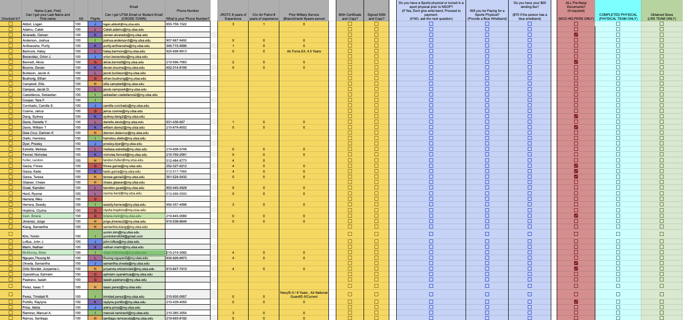
Completed
Updated Cadet Check-In Spreadsheet and Flight Roster
116 Recruits
19-20 Cadets per Flight
Nurse Availability (1 of 2)
Katelynn Gutz
Followed up with Organizations
Designated Rooms
Finalized/Specified Volunteer Positions
Campus Tour Video
Created GLP’s
Finalized NSOP Plan
Air Force ROTC Detachment 842 • We Build Exceptional Officers • The University of Texas at San Antonio

Slide 4
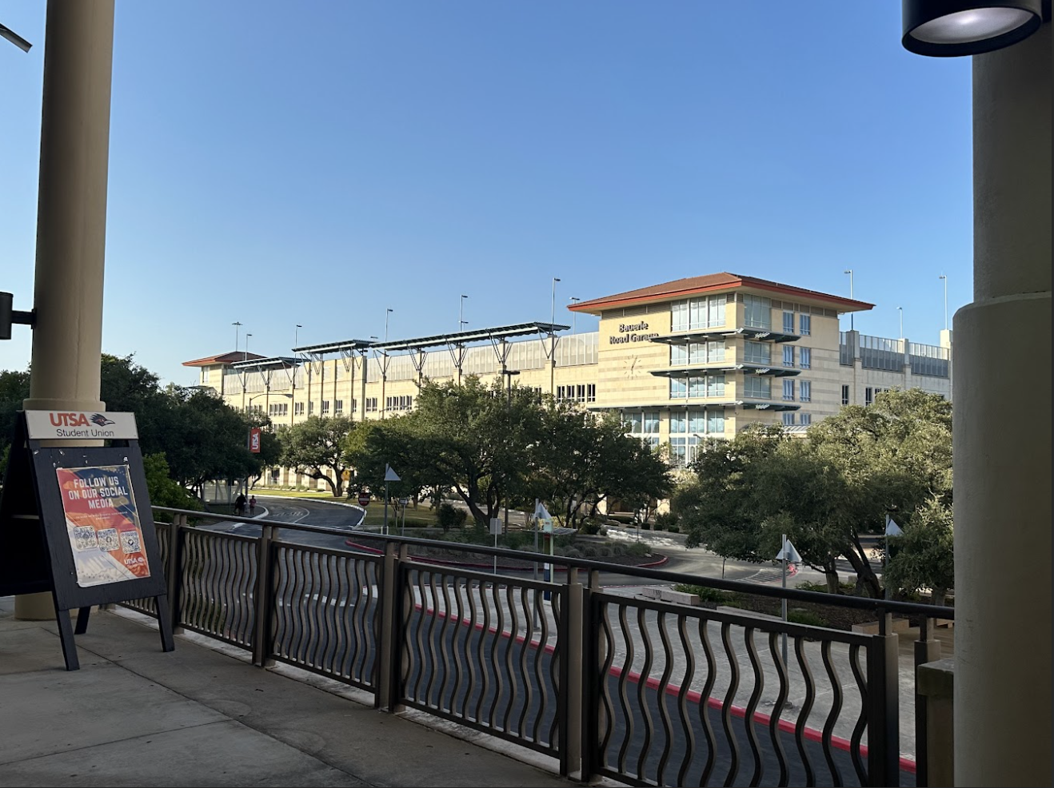
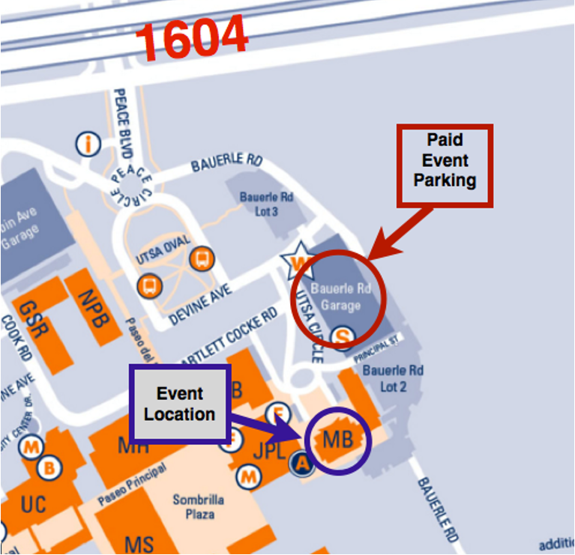

Email Drafts
Emails Sent
Check-in Survey
NSOP Required Items
NSOP Parking/UOD
Nurse Availability/Instruction
Pre-NSOP Paperwork Opportunity
Sport Physical Options
Week One Overview
Week One Uniform Wear
Full Email Summary
Air Force ROTC Detachment 842 • We Build Exceptional Officers • The University of Texas at San Antonio

Slide 5
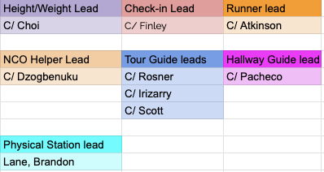
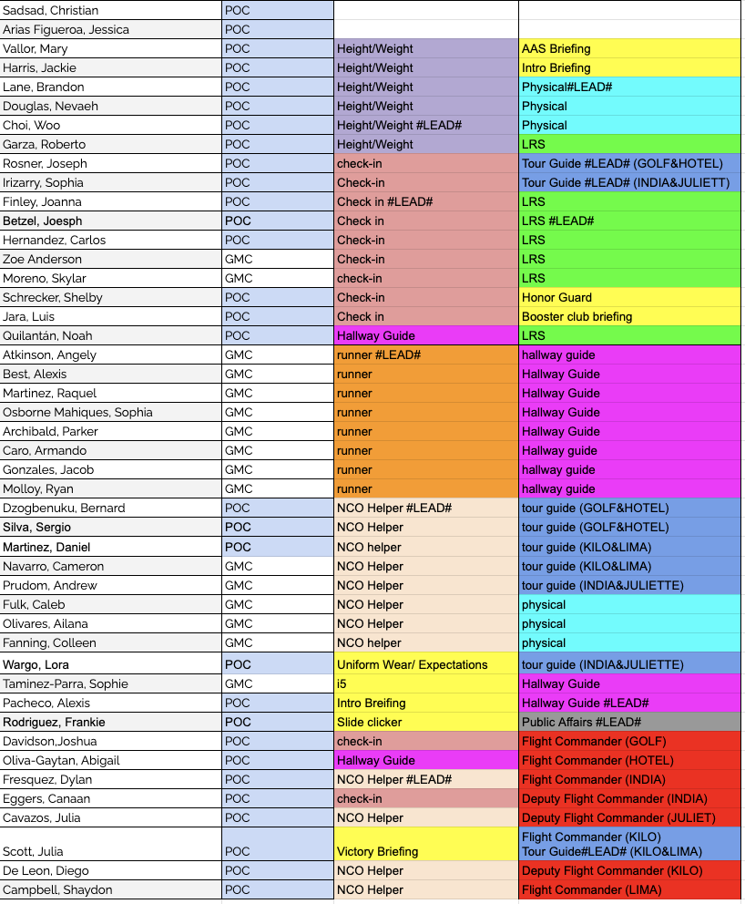
Volunteers
44 Volunteers
Volunteer Leads
Height/Weight: C/Choi
Check-in: C/Finley
Runner: C/Atkinson
NCO Helpers: C/Dzogbenuku, C/Fresquez
Tour Guides: C/Rosner, C/Irizarry, C/Scott
Physicals: C/Lane
Hallway Guide: C/Pacheco
Public Affairs: C/Rodriguez, F
Air Force ROTC Detachment 842 • We Build Exceptional Officers • The University of Texas at San Antonio

Slide 6
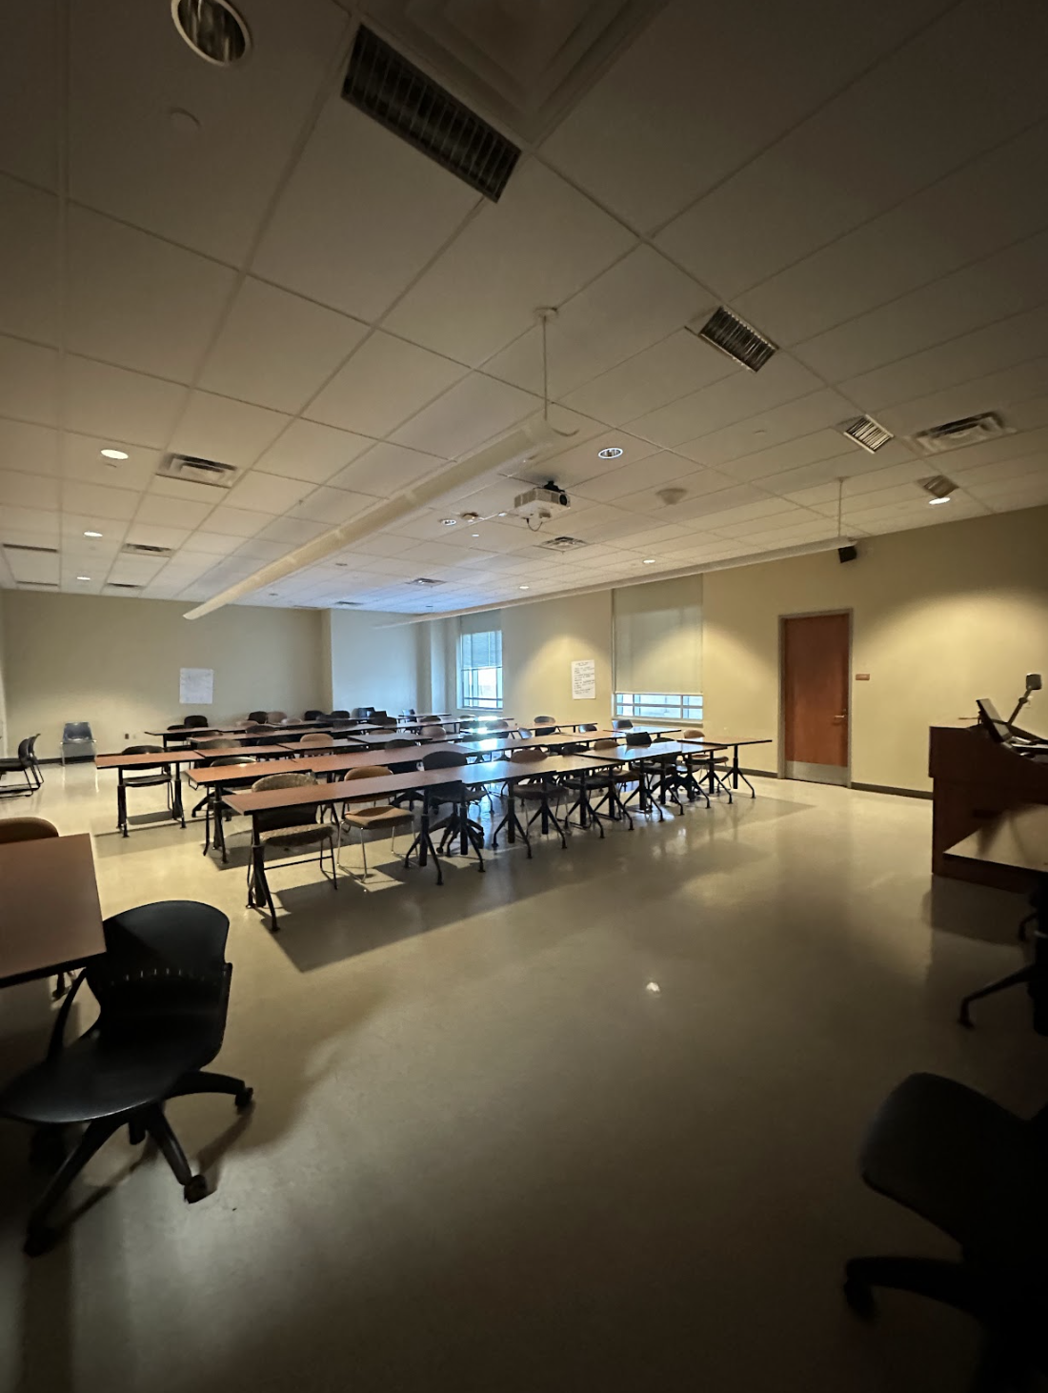
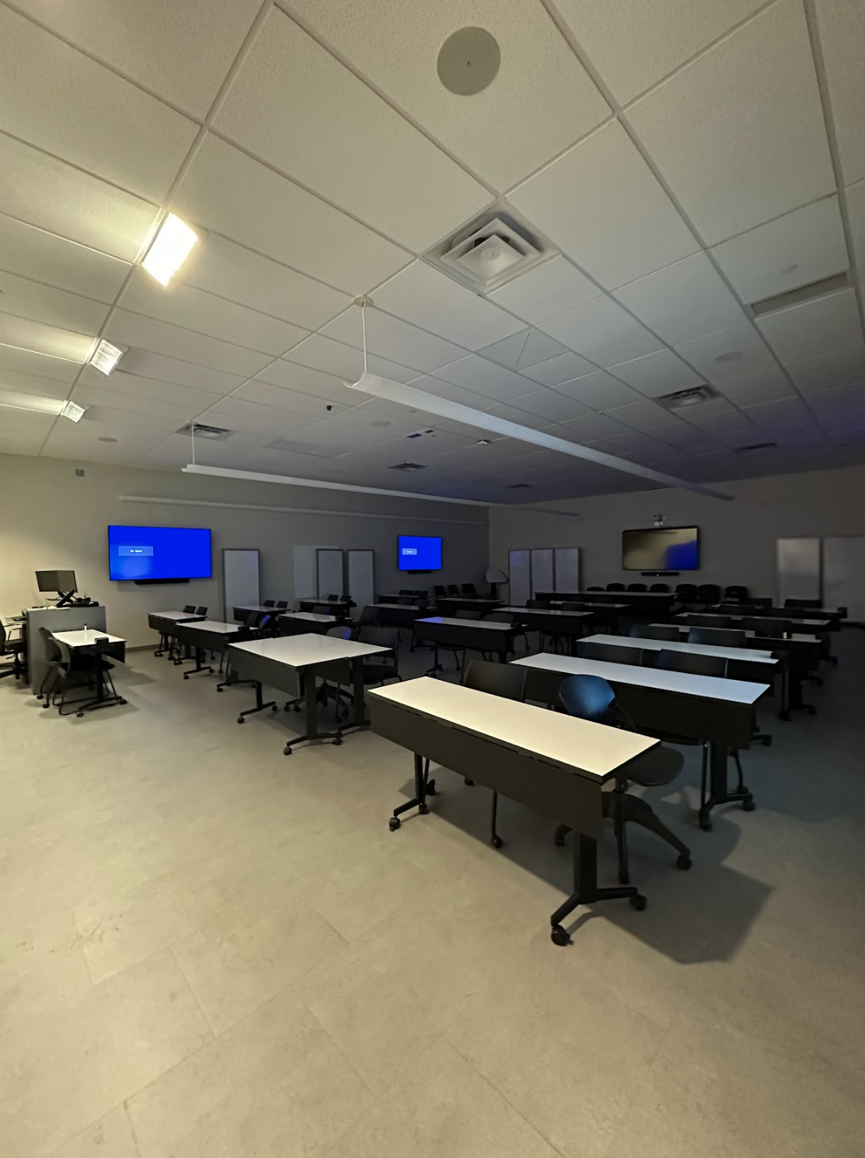
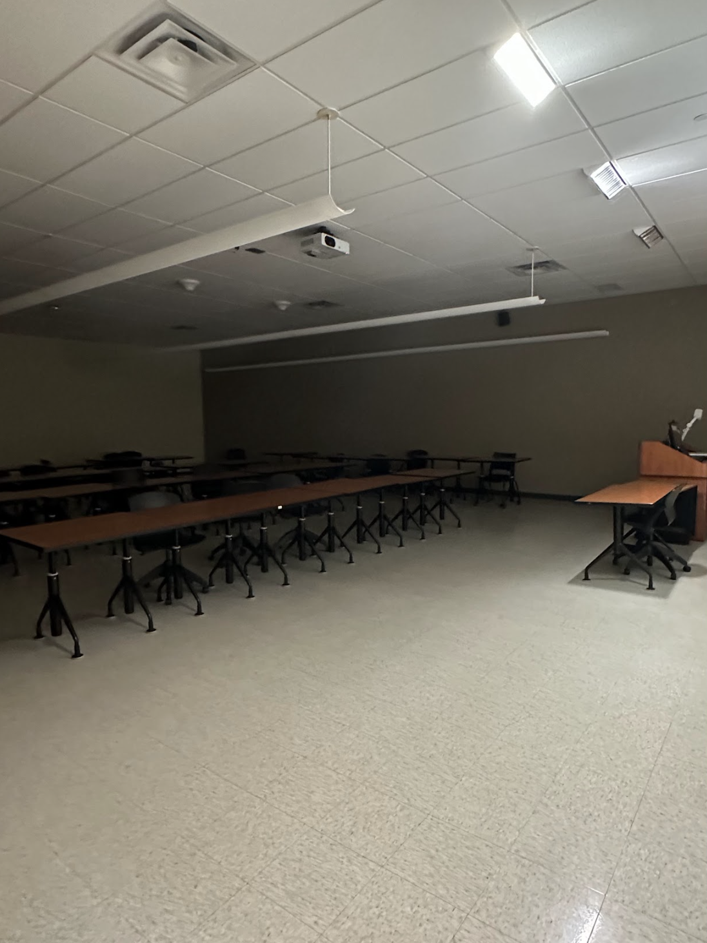
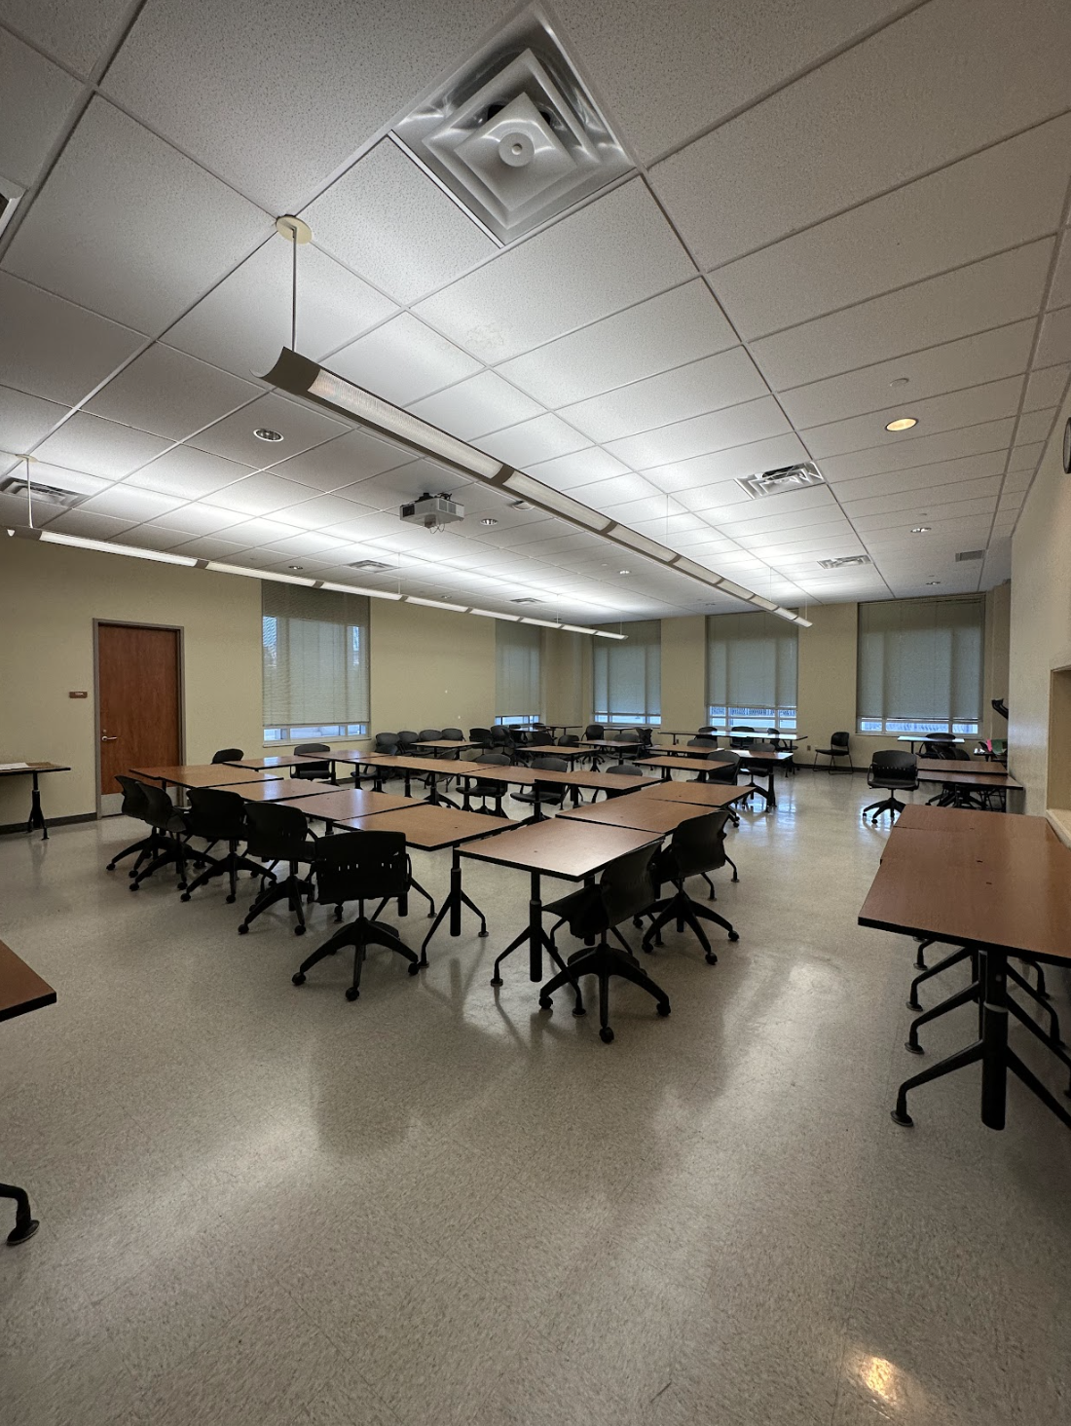
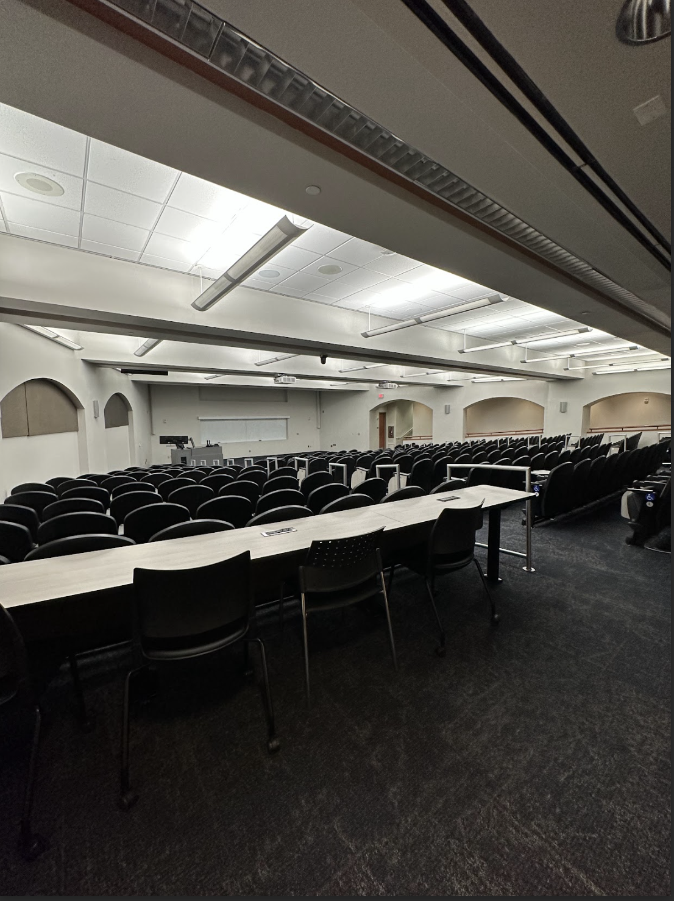
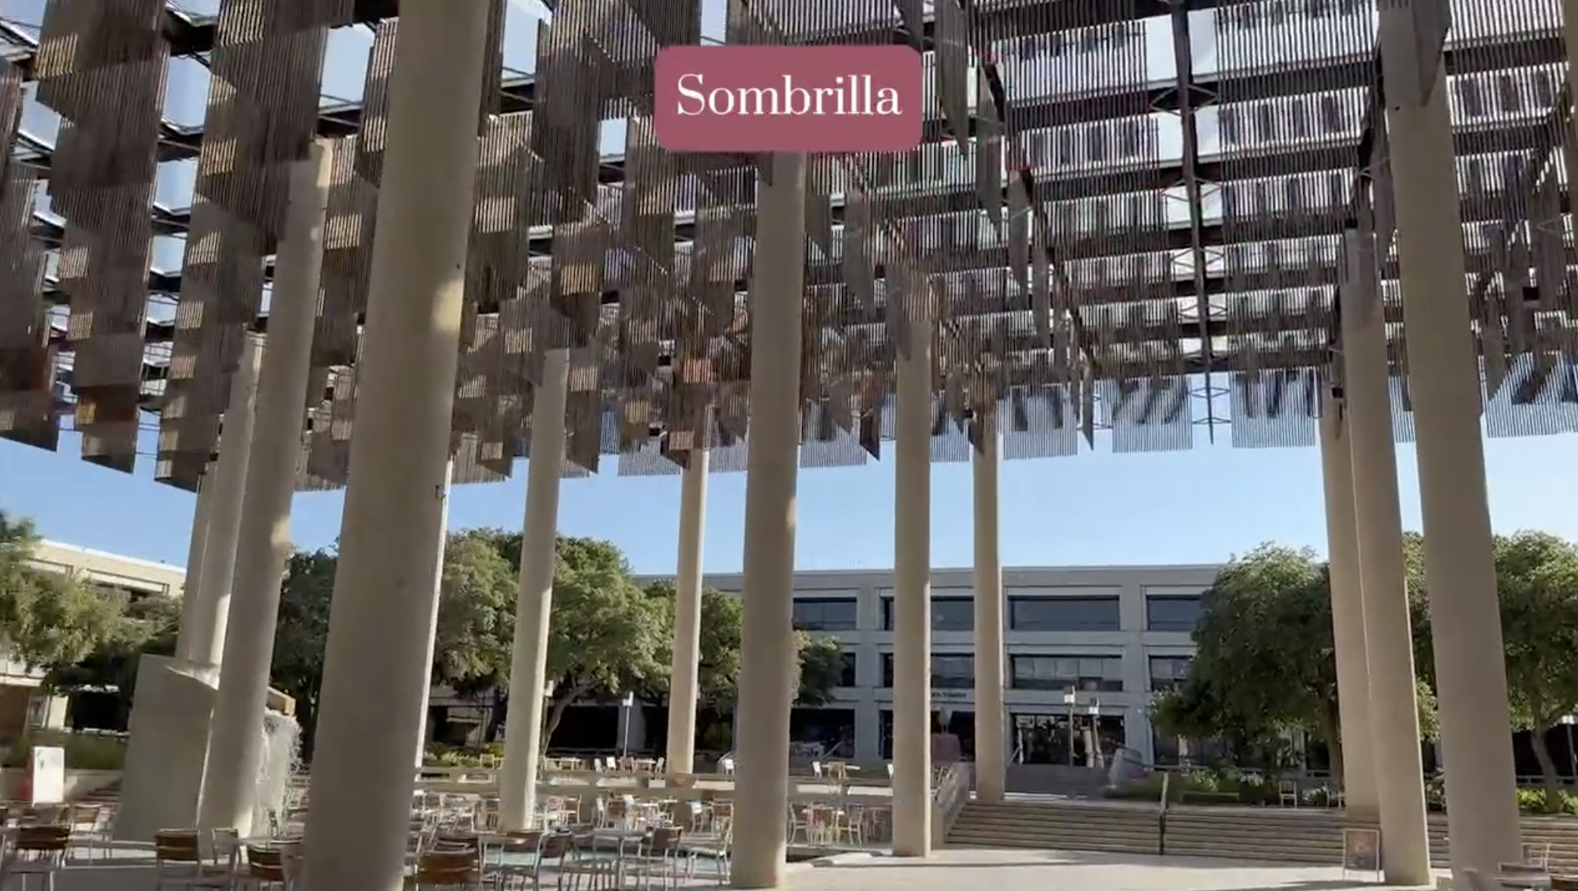
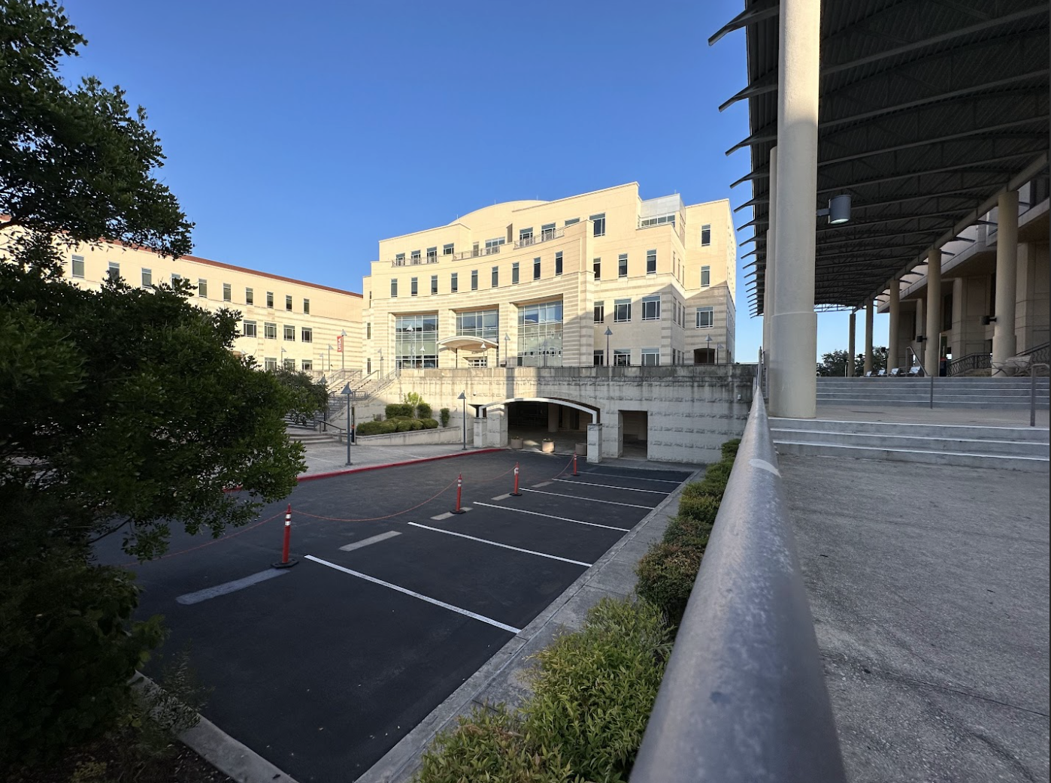
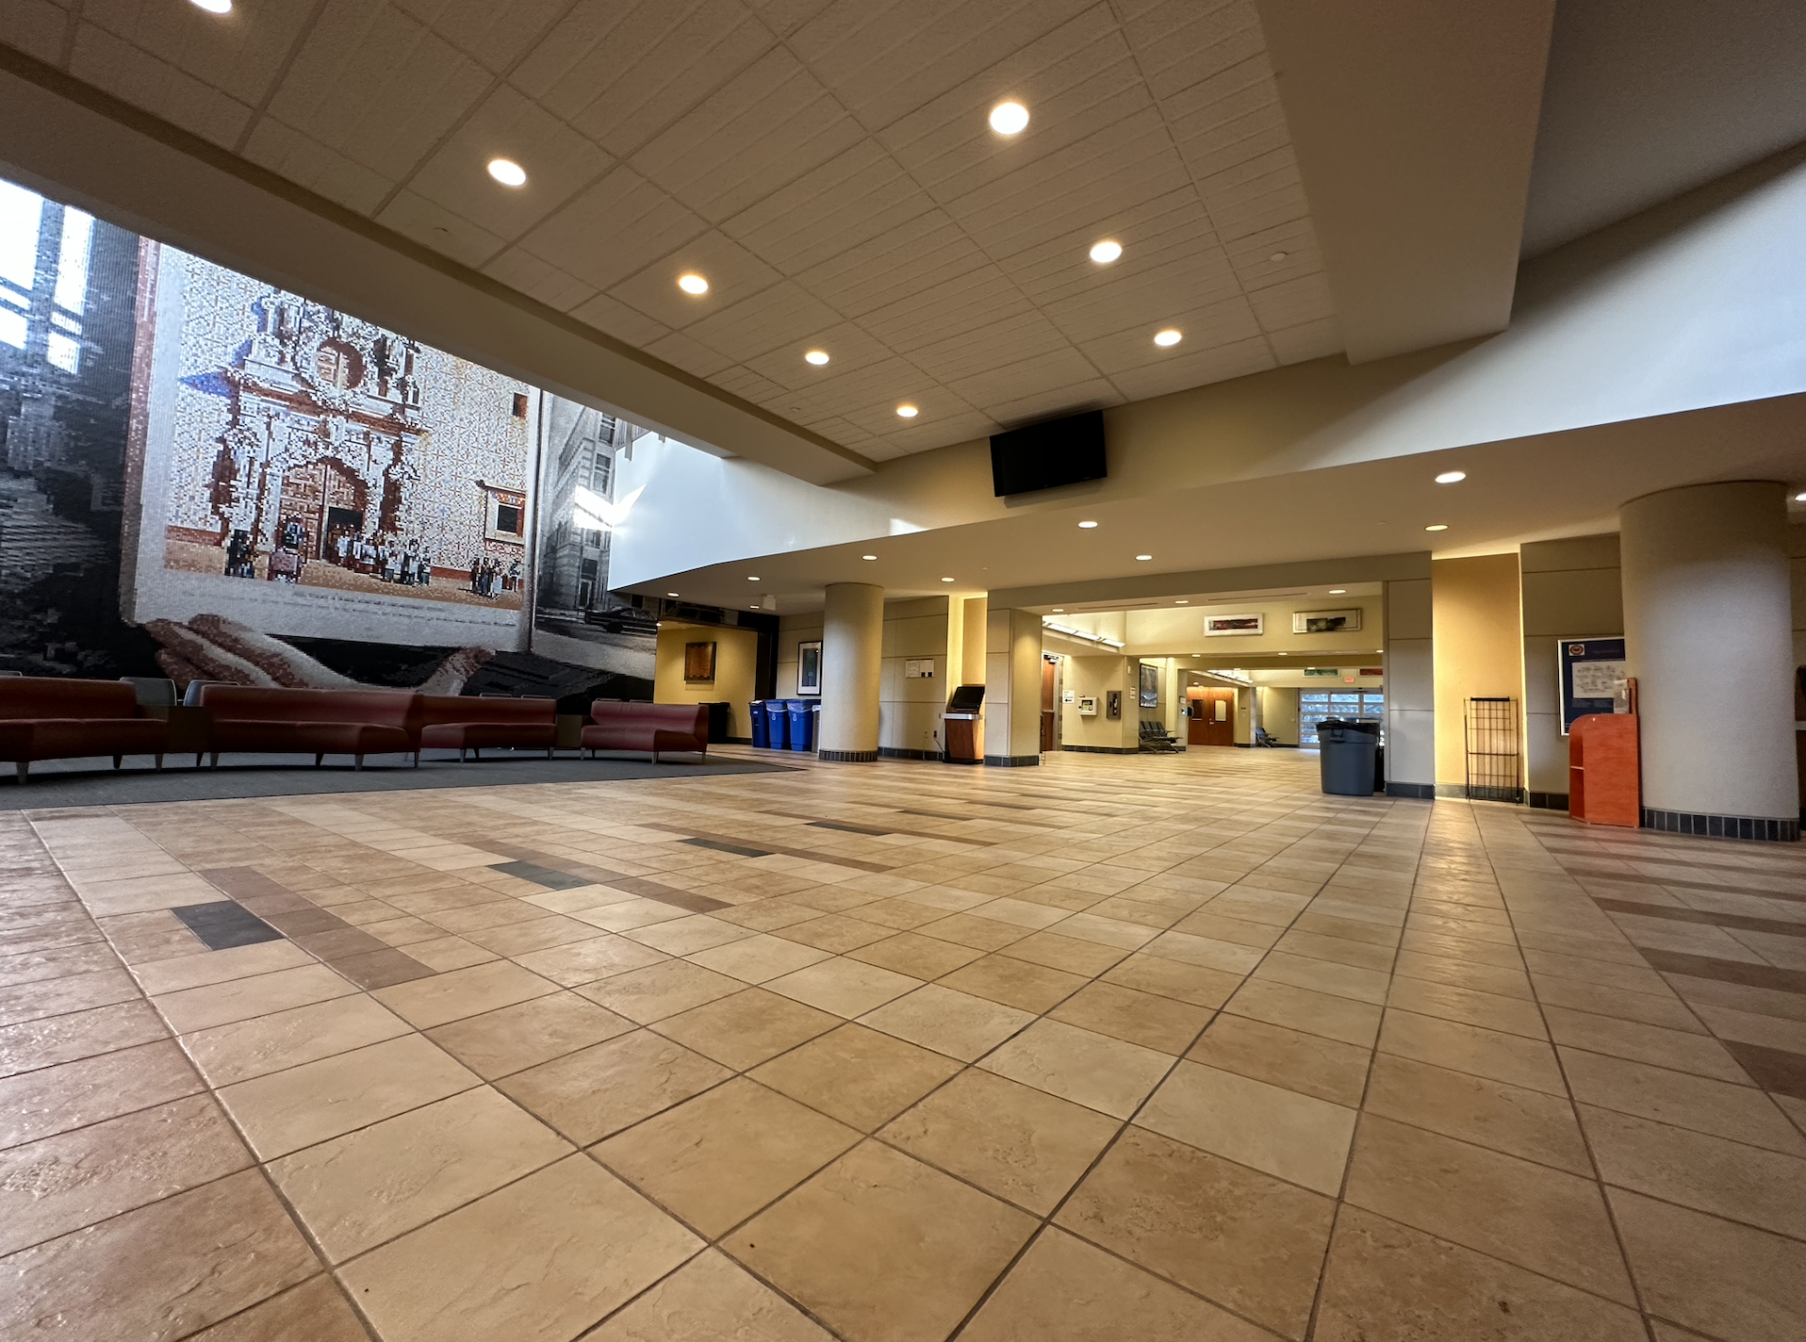
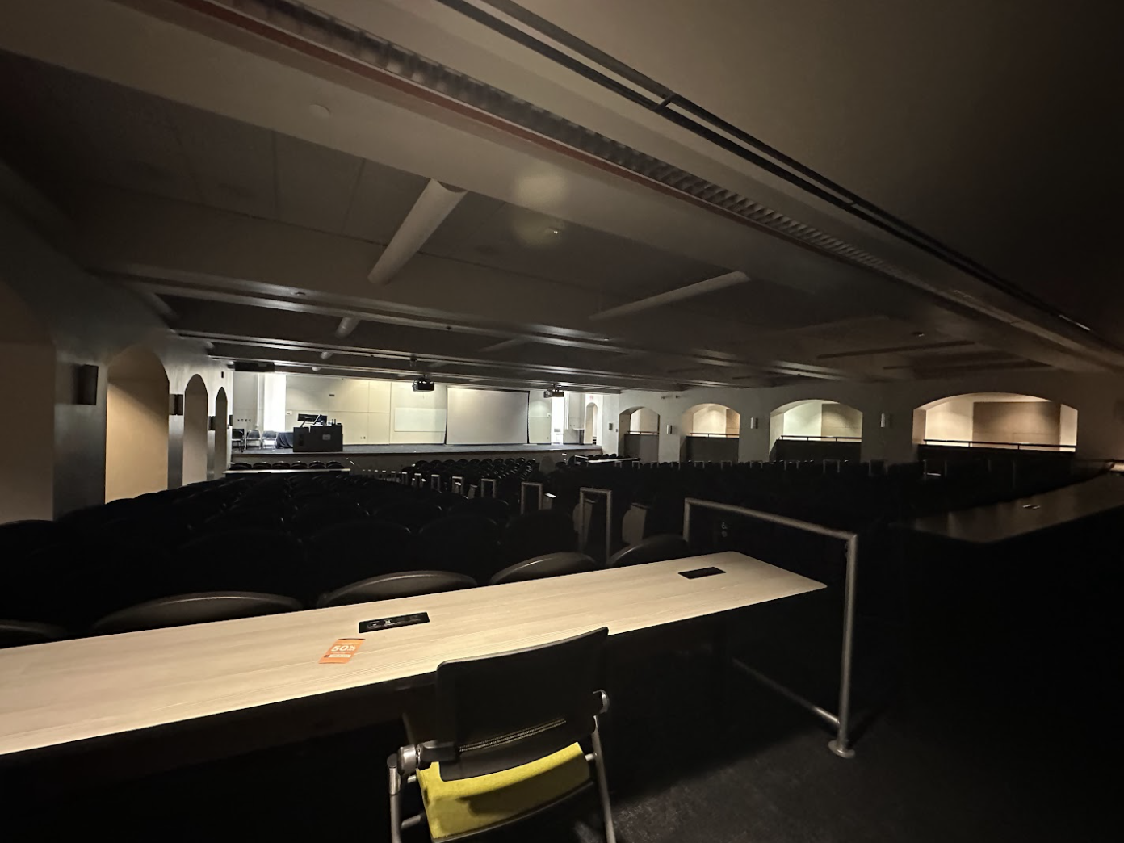
Designated Rooms
Room 1.126: Waiting Room/GLP
Room 0.106: Left Side Auditorium
Room 1.124:LRS
Room 1.122:
Sport Physical 1
Room 1.120:
Sport Physical 2
Hallway:
Height/Weight and Check-in
Room 0.104: Right Side auditorium
Sombrilla: Lunch
Main Building
Air Force ROTC Detachment 842 • We Build Exceptional Officers • The University of Texas at San Antonio

Slide 7

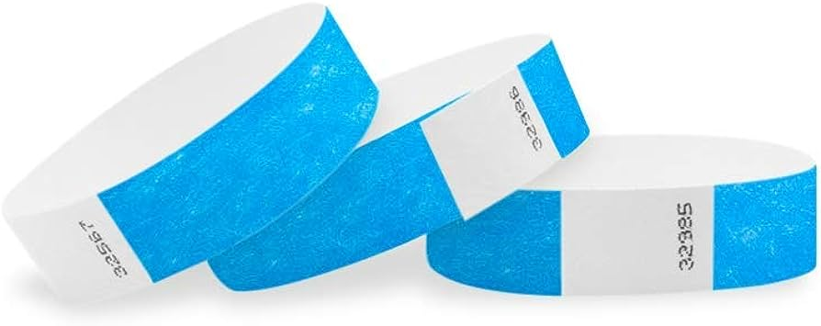

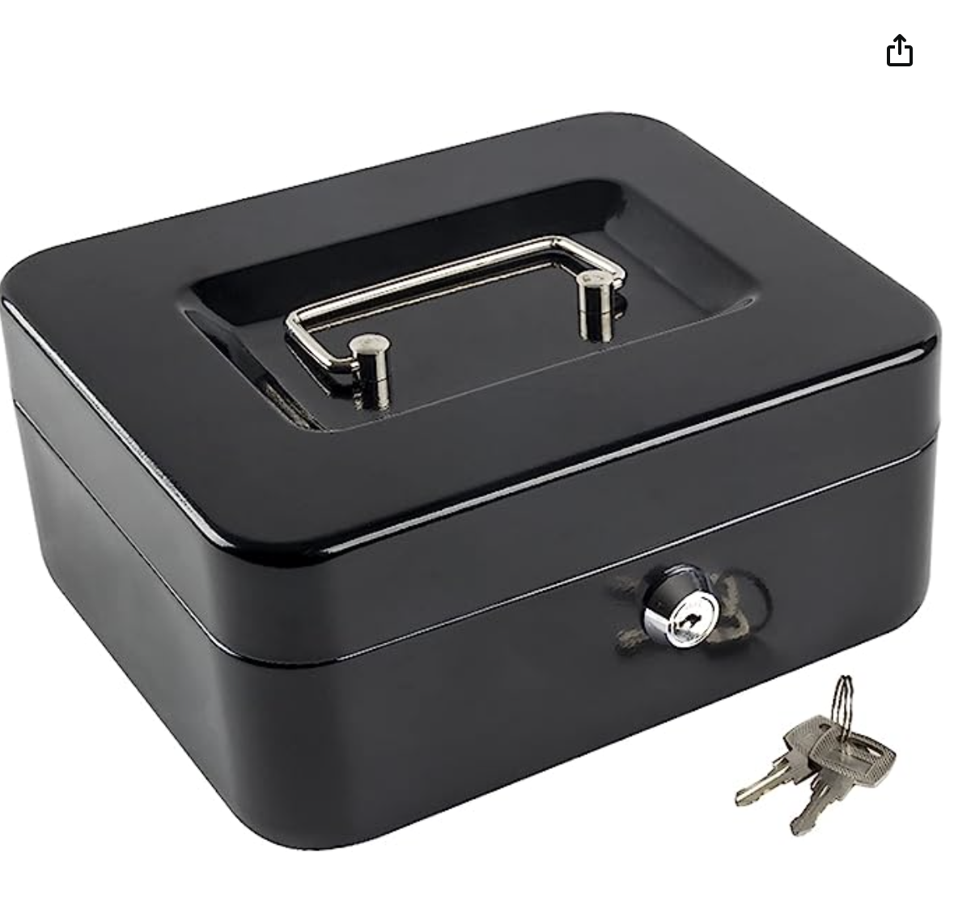
Logistics
Wristbands
Cadets that will Require a Sports Physical = Blue
Cadets who have finished with Height/Weight = Green
12 Radios
Volunteers will be all in one channel in the morning, separate channels when flights occur.
Cash Container
Handled only by Booster Club
3 Height/Weight Scales
Tables
4 from us, may use tables from MB
Signs
Locations for NSOP, LRS, H/W, Physicals
Air Force ROTC Detachment 842 • We Build Exceptional Officers • The University of Texas at San Antonio

Slide 8

Projected Dates
Dry Run Date/Time
Aug 16, Wed at 1100 - 1200
NSOP Date/Time
August 18, Fri at 0645 - 1630
Air Force ROTC Detachment 842 • We Build Exceptional Officers • The University of Texas at San Antonio

Slide 9
Rotations
Group Rotations
Station 1: Sport Physical/GLP
Station 2: LRS
Station 3: Campus Tour/Q&A
Golf/Hotel
Lead: C/Rosner
(Station 1,2,3)
Rotation 1: 1300-1345
Sport Physical/GLP
Rotation 2: 1355-1440
LRS
Rotation 3: 1450-1535
Campus Tour/Q&A
India/Juliette
Lead: C/Irizarry
(Station 2,3,1)
Rotation 1: 1300-1345
LRS
Rotation 2: 1355-1440
Campus Tour
Rotation 3: 1450-1535
Sport Physical/GLP
Kilo/Lima
Lead: C/Scott
(Station 3,1,2)
Rotation 1: 1300-1345
Campus Tour/Q&A
Rotation 2: 1355-1440
Sport Physical/GLP
Rotation 3: 1450-1535
LRS
Air Force ROTC Detachment 842 • We Build Exceptional Officers • The University of Texas at San Antonio

Slide 10
Finalized NSOP Plan
Entrance: 06:45 - 07:45 (1 hour)
Volunteer arrival, expectations, equipment/room setup
Arrival of Cadets: 08:00 - 09:00 (1hour, will start upon first cadet arrival)
Height and Weight → Check-in table → Left side Auditorium
Cadets that have completed Height and Weight will receive a Green Wristband
Cadets without a sport physical will receive a Blue Wristband
NCO Time: 9:10-11:10 (2 Hours)
Those who haven’t completed documents will stay in the Left Side Auditorium with SSgt Barnes to complete Paperwork.
Those with completed documents will proceed with SSgt Taylor to upload paperwork into WINGS and go from applicant to an active cadet.
Right side Auditorium: 11:20-12:10 (1hour, 10 min)
Flight Arrangements
Briefings: Col Cyrus Briefing, Wingstaff Intro, Group Organization, Uniform wear and Expectations
Question and Answers
Air Force ROTC Detachment 842 • We Build Exceptional Officers • The University of Texas at San Antonio

Slide 11
Finalized NSOP Plan
Lunch at Sombrilla: 12:20 - 12:50 (30 min)
Lunch provided by Booster Club
Volunteers will ensure food/drinks are ready upon cadet arrival
Group Rotations: 13:00 - 13:45 , 13:55 - 14:40, 14:50 - 15:35
Golf/Hotel: Sport Physical/GLP → LRS → Campus Tour
India/Juliette: LRS → Campus Tour → Sport Physical/GLP
Kilo/Lima: Campus Tour → Sport Physical/GLP → LRS
Finale (15:45 - 16:00)
All rotations return to the Main Building, final words will be shared and new cadets will be dismissed.
Back-Up Physical Time/ Clean Up (16:00 - 16:30)
Recruits who haven’t completed their sports physical will have a 30 min towards the end of NSOP. Time will also be utilized for clean-up.
Air Force ROTC Detachment 842 • We Build Exceptional Officers • The University of Texas at San Antonio

Slide 12
Summary
Completed
Email Drafts
Volunteers
Designated Rooms
Logistics
Projected Dates
Rotations
Rough Draft
Air Force ROTC Detachment 842 • We Build Exceptional Officers • The University of Texas at San Antonio

Slide 13
Questions?

Slide 14
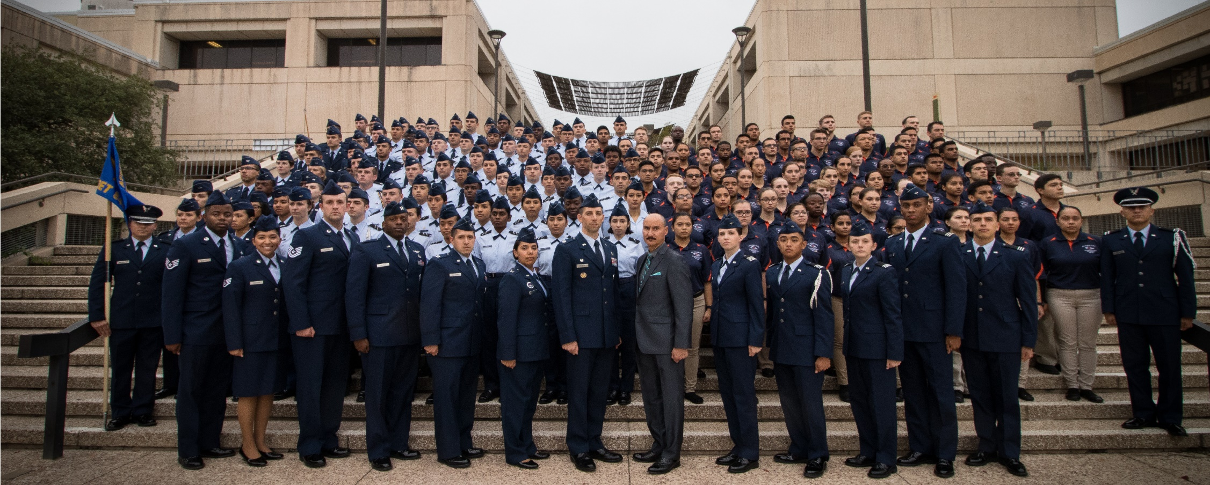
Air Force ROTC Detachment 842
The University of Texas at San Antonio
Det 842 – Best in Blue

